Slide 1
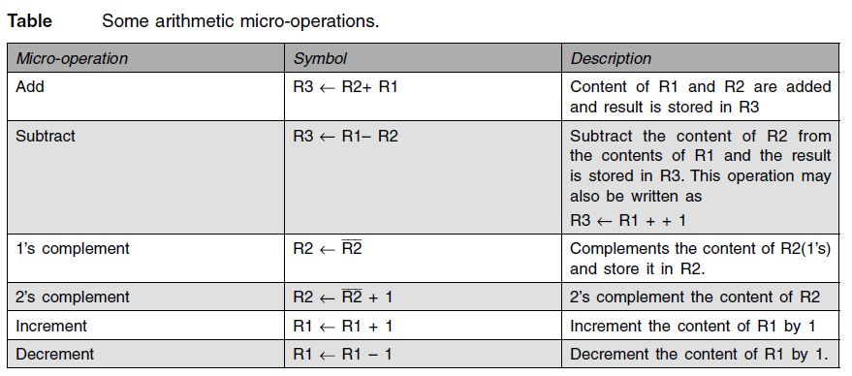
Arithmetic & logic unit design
The arithmetic micro-operations listed in Table can be implemented in one composite arithmetic circuit.
The basic component of an arithmetic circuit is the parallel adder. By controlling the data inputs to the adder, it is possible to obtain different types of arithmetic operations.

Slide 2
4-bit arithmetic circuit
It has four full-adder circuits that constitute the 4-bit adder and four multiplexers for choosing different operations.
There are two 4-bit inputs A and B and a 4-bit output D. The four inputs from A go directly to the X inputs of the binary adder.
Each of the four inputs from B is connected to the data inputs of the multiplexers. The multiplexers data inputs also receive the complement of B.
The other two data inputs are connected to logic-0 and logic-1. Logic-0 is a fixed voltage value and the logic-1 signal can be generated through an inverter whose input is 0.
The four multiplexers are controlled by two selection inputs, S1, and S0.
The input carry Cin goes to the carry input of the FA in the least significant position. The other carries are connected from one stage to the next.
The output of the binary adder is calculated from the following arithmetic sum:
D = A + Y + Cin

Slide 3
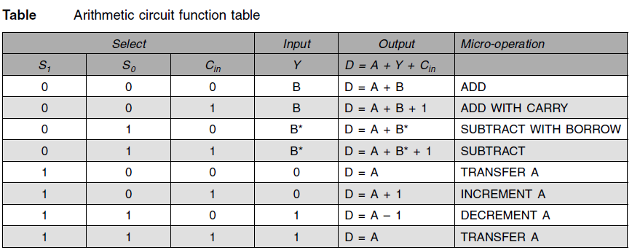
where A is the 4-bit binary number at the X inputs and Y is the 4-bit binary number at the Y inputs of the binary adder. Cin is the input carry, which can be equal to 0 or 1.
Note that the symbol + in the equation above denotes an arithmetic plus.
By controlling the value of Y with the two selection inputs S1 and S0 and making Cin equal to 0 or 1, it is possible to generate the eight arithmetic micro-operations listed in Table

Slide 4
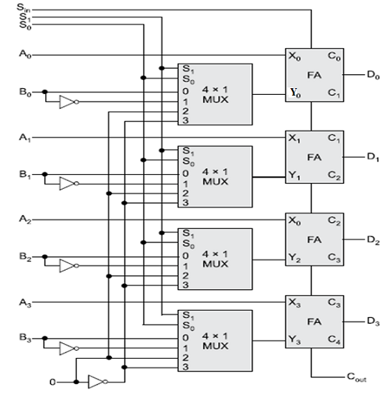
Diagram: 4-bit arithmetic circuit

Slide 5
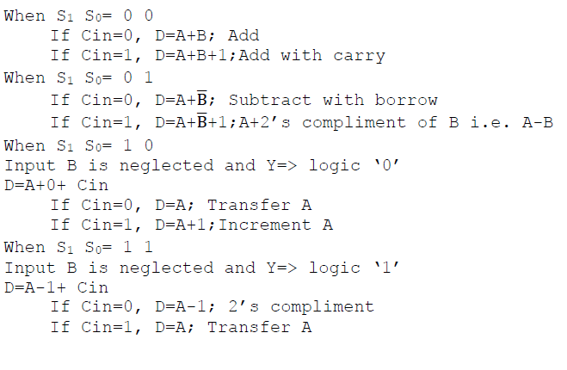

Slide 6
Addition:
When S1S0= 00, the value of B is applied to the Y inputs of the adder.
If Cir, = 0, the output D =A+B.
If Cin = 1, output D=A+B + 1.
Both cases perform the add micro-operation with or without adding the input carry.
Subtraction:
When S1S0 = 01, the complement of B is applied to the Y inputs of the adder.
If Cin = 1, then D = A + B + 1. This produces A plus the 2's complement of B, which is equivalent to a subtraction of A -B.
When Cin = 0 then D = A + B. This is equivalent to a subtract with borrow, that is, A-B-1.
Increment:
When S1S0 = 10, the inputs from B are neglected, and instead, all 0's are inserted into the Y inputs. The output becomes D = A + 0 + Cin. This gives D = A when Cin = 0 and D = A + 1 when Cin = 1.
In the first case we have a direct transfer from input A to output D.
In the second case, the value of A is incremented by 1.

Slide 7
Decrement:
When S1S0= 11, all l's are inserted into the Y inputs of the adder to produce the decrement operation D = A -1 when Cin = 0. This is because a number with all 1's is equal to the 2's complement of 1 (the 2's complement of binary 0001 is 1111).
Adding a number A to the 2's complement of 1 produces F = A + 2's complement of 1 = A - 1. When Cin = 1, then D = A - 1 + 1 =A, which causes a direct transfer from input A to output D. Note that the micro-operation D = A is generated twice, so there are only seven distinct micro-operations in the arithmetic circuit.

Slide 8
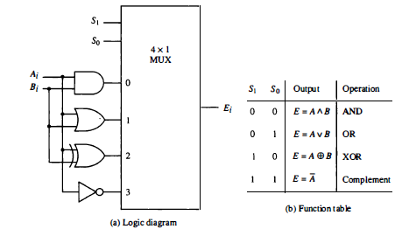
Logic Micro-operations

